Slide 1
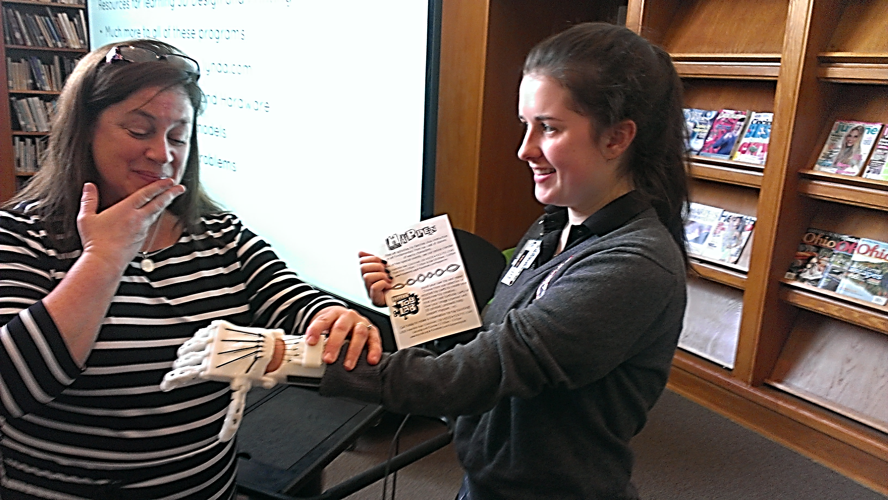
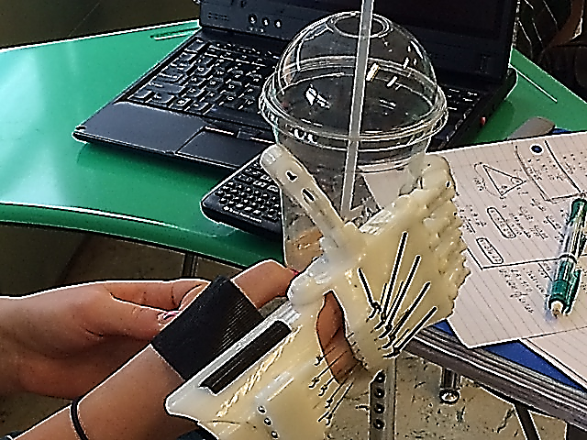
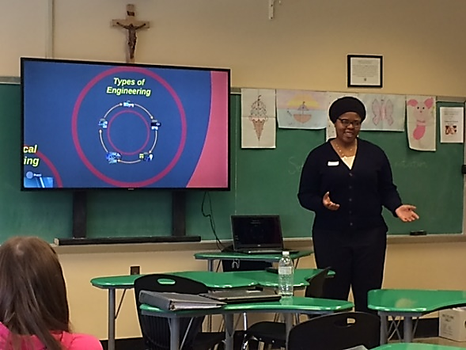
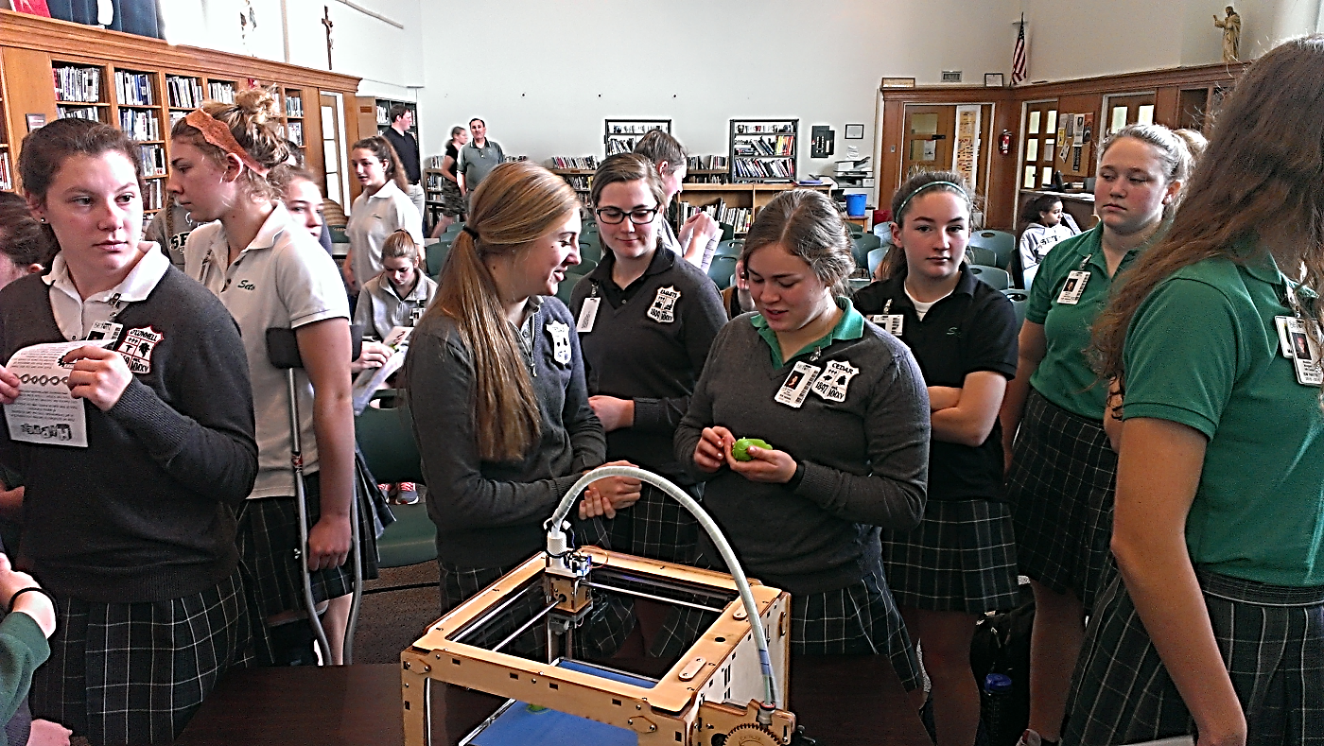
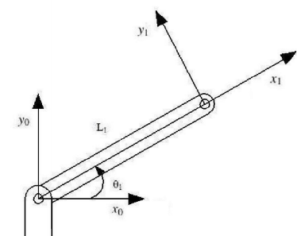
Real World Applications of Trigonometry Temiloluwa Adeniyi, COFSP Fellow, Seton High School, Pre-Calculus, Mrs. Gina Rider
RET is funded by the National Science Foundation, grant # EEC-1404766
Unit Overview
Activity Implementation
Student Work
Topic: Real World Applications of Trigonometry
Standards:
Next Generation Science Standards
Asking questions and defining problems
Systems and systems models
Constructing Explanations and designing solutions
Systems and system models
Obtaining, evaluating and communicating information
Ohio’s New Learning Standards for Science (ONLS)
Designing Technological/Engineering Solutions Using Science concepts
Mini- lesson in the form of a Prezi
Incorporated class discussion and multi- media
Reviewed definition of co-terminal angles, hypotenuse and example problems of applications including a robotic arm.
Followed later by the opportunity for students to experience 3D printed prosthetic hands
Student Using Prosthetic Hand
Assessment Results:
Impact on Student Learning
Activity Structure
Title: Real World Applications of Trigonometry
Guiding Questions:
How can the Pythagorean formula be used to describe the maximum length the robotic arm?
How can it be used for the 2 link diagram?
Using this constraint of possible values, as well as an additional constraint that L_2 can’t be shorter than L_1, what possible values can be used to create your own system?
Objectives:
Applications of Trigonometry with Animated 2 Link Robotic Arm
Determine the domain of a system of equations that describe a real life system.
Apply fundamental trigonometric concepts to engineering design scenarios in creation of individual systems that meet design parameters.
Student Holding Prosthetic Hand
Activity Implementation
Follow Up Activity with 3D Printing
Engineering Design Process
In question 3, the students were challenged to design their own robotic arm that met the design parameters.
Applications
GPS signals in cars
Landscaping and construction
3D Printed prosthetic robotic arms
Careers
Biomedical Engineering
Societal Impact
Making 3d printed prosthetic hands for kids
cal device design for children
Reflection and Conclusion
Activity went well.
Students demonstrated increased understanding
Increase in percentage of correct answers for all five questions.
Most growth shown in identifying functional engineering systems using trigonometric design parameters.
Possible changes: explain the design question in more detail and use a more clear diagram

